Slide 1
Chapter 11 Customer service and sustainability

Slide 2
Topics Covered
Introduction to sustainability
Sustainable travel
Sustainability initiatives in different sectors of hospitality and tourism
Sustainability and customer service

Slide 3
‘At Your Service’ Spotlight: Ewald Biemans, Bucuti & Tara in Aruba
Ewald Biemans is owner of Bucuti & Tara Beach Resort in Aruba, and is well known for being an environmental preservation pioneer.
“We’ve made sustainability a real science. There’s no plastic used anywhere at the resort, which has reduced our trash by 60%. All food scraps and leftover food are donated to local farmers for their animals. Guests use an electronic signature at check in instead of paper. We recycle every drop of water. Our state-of-the-art air-conditioning system uses 30% less energy than other systems”.
"I think our guests appreciate our efforts and feel good with what we’re doing. It’s a right of life to go on a vacation, and what’s happening here gives our guests a dispensation to enjoy themselves and help sustain the environment at the same time."

Slide 4
Introduction to sustainability
Sustainability is the practice of meeting present needs without compromising the ability of future generations to meet their own needs. It encompasses a holistic approach that considers environmental health, economic viability, and social equity.
Sustainability aims to balance these three pillars to ensure long-term prosperity and well-being for both people and the planet (see next slide)
It was 1972 when sustainability was first used in a similar context as it is today, regarding the future of humanity. Then in 1987, the ‘Our Common Future’ report by the UN Brundtland Commission was published, which popularized the term sustainable development: “development that meets the needs of the present without compromising the ability of future generations to meet their own needs”
On June 23, 1988, global warming became recognized on a wider scale after a NASA scientist testified to the world that the climate was changing.
By the 1990s, sustainability had become a familiar term in the world of policy jargon. From this point forward, sustainability exploded in the digital age, to the point where there is a superabundance of information on the subject.

Slide 5
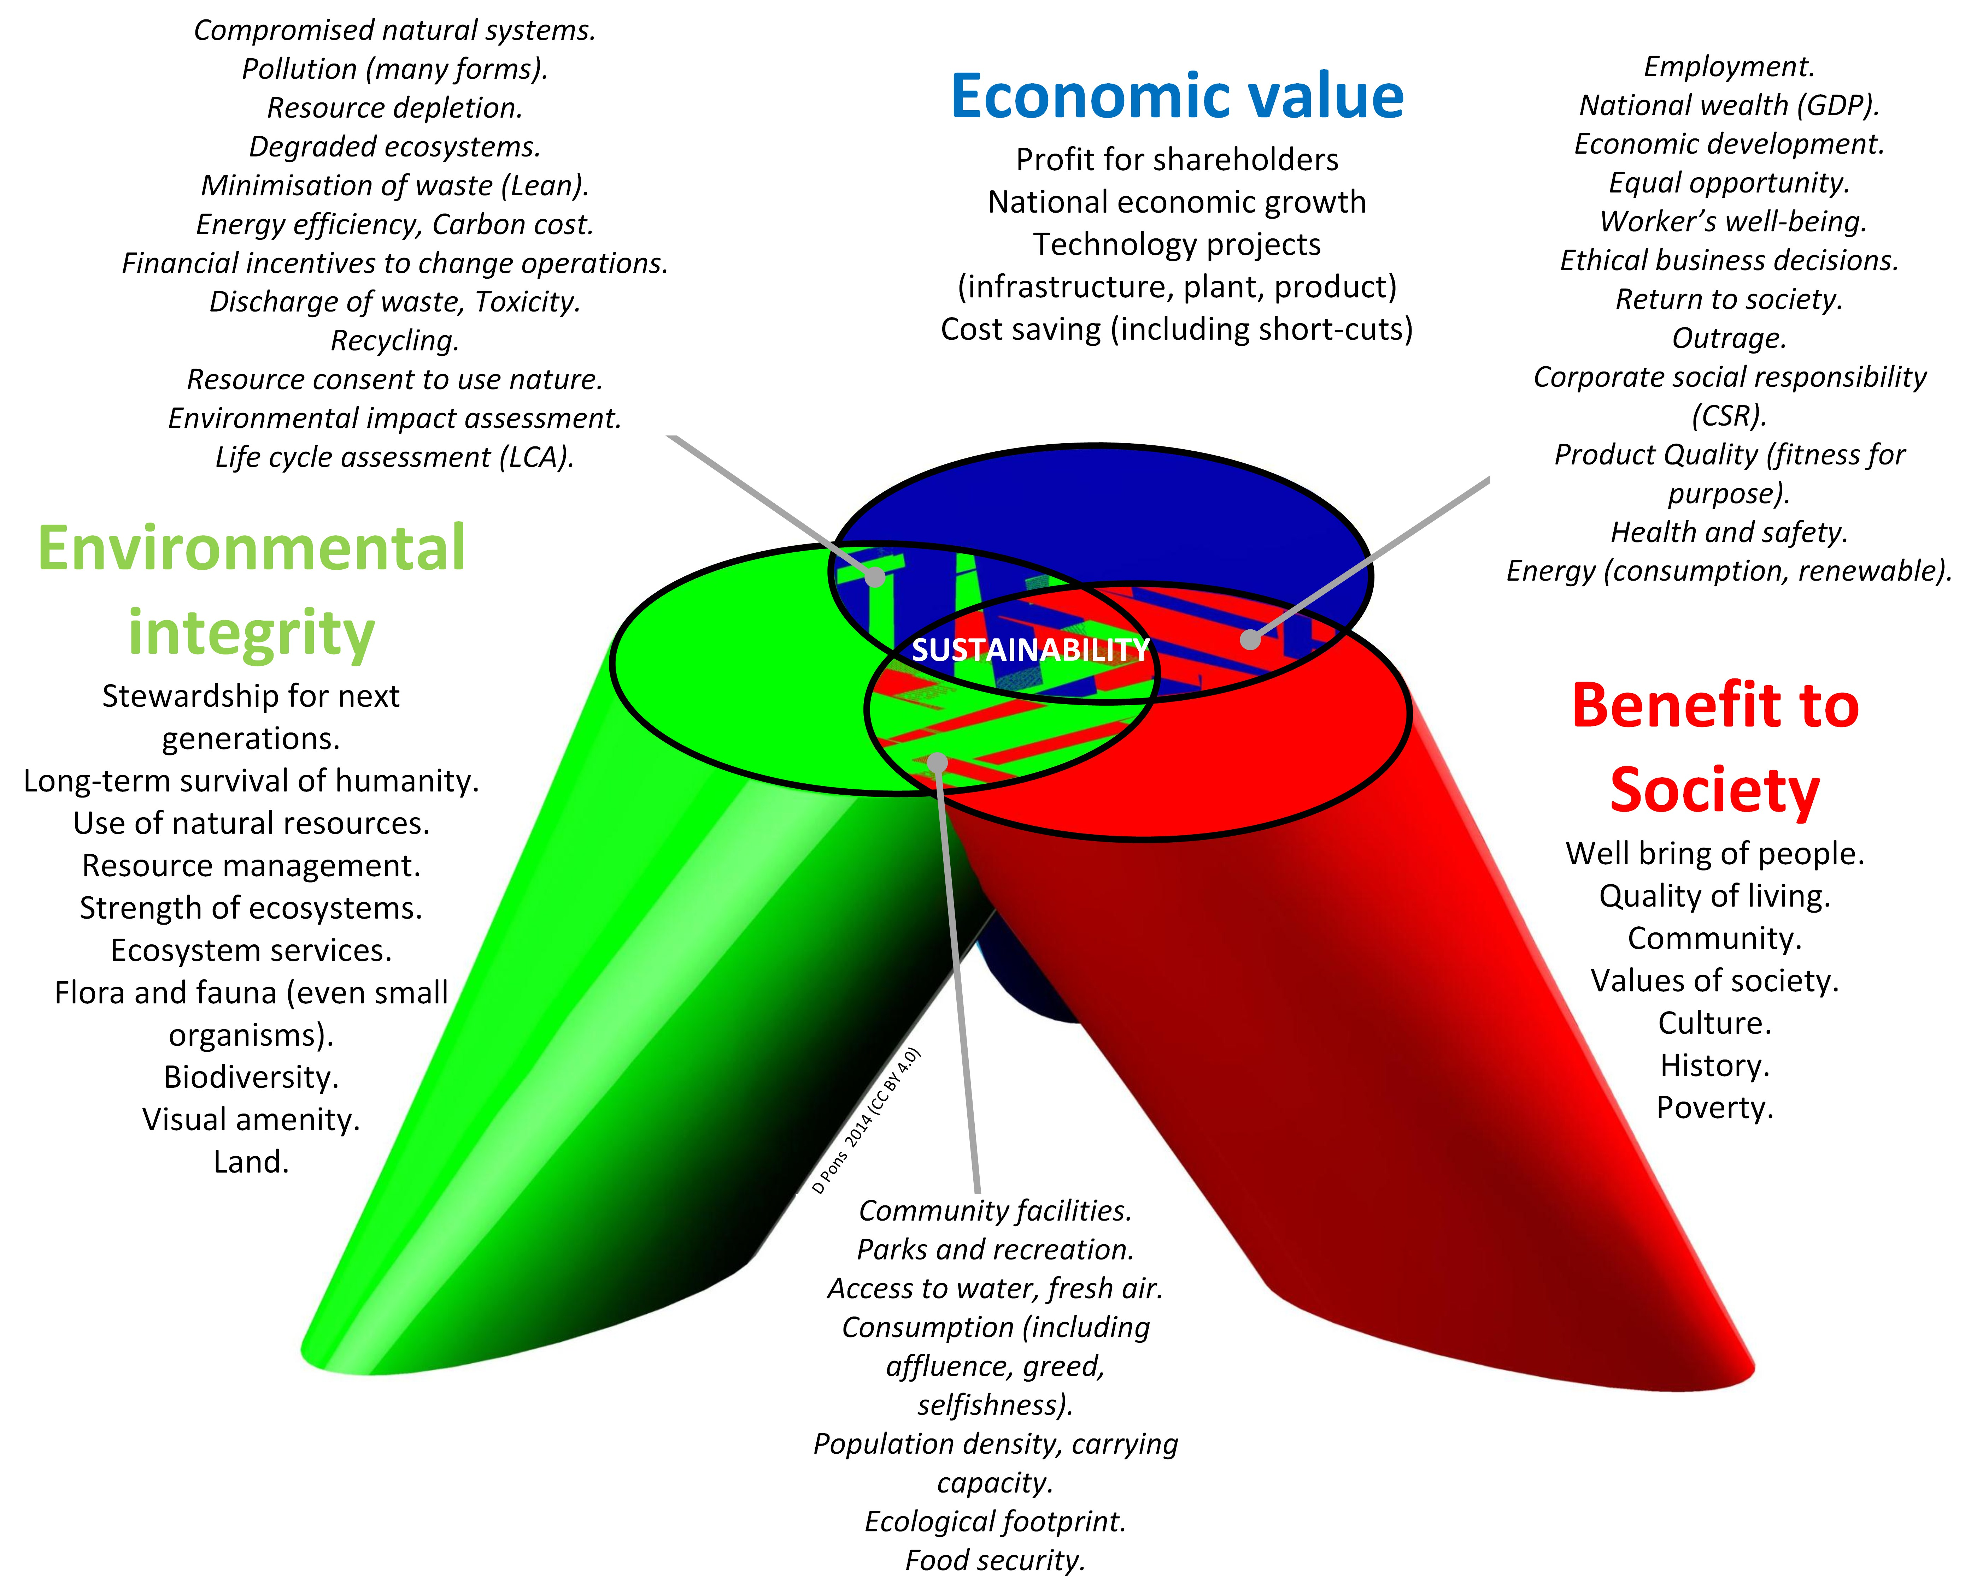
Three pillars model of sustainability

Slide 6
Sustainable travel
Sustainable travel has emerged as a significant trend in the last few decades. The UNWTO define sustainable tourism as: "Tourism that takes full account of its current and future economic, social and environmental impacts, addressing the needs of visitors, the industry, the environment and host communities"
To guide key-players in tourism development the UNWTO has developed a Global Code of Ethics for Tourism (GCET), a comprehensive set of principles. The Code’s ten principles amply cover the economic, social, cultural and environmental components of travel and tourism.
In the academic world, research into sustainability in the tourism and hospitality sector has grown significantly, in areas such as tourism and the environment, sustainable consumer behavior, accessibility in tourism, and measuring the impact of sustainable policies in the industry

Slide 7
Sustainability in the hospitality sector: Destinations
Today, an increasing number of destinations are adopting measures to limit numbers to be more sustainable. Bhutan in Southeast Asia for example follows a policy of ‘High Value, Low Volume’ that promotes sustainable tourism based on carrying capacity.
Visitors to Palau in the West Pacific are even being incentivized to be ‘good travelers’. In a world-first initiative, visitors to the country made up of 300-plus islands are offered exclusive experiences based on how they treat the environment and culture, not by how much they spend.
Palau had already implemented the Palau Pledge in 2017 which requires international visitors to sign a pledge stamp in their passports that promises the children of Palau that they will ‘tread lightly’ and ‘preserve and protect’ the islands.

Slide 8
Sustainability in the hospitality sector: Hotels
The three case studies in this chapter are good examples of hotels adopting sustainable policies
Other hotels featured in this book have recognized the impor- tance of introducing sustainability initiatives. The Lopesan Group for example, profiled in Chapter 1, recently obtained the international certification in sustain- ability, Biosphere Certified.
This recognition endorses the company’s sustainable commitments to environmental protection, socio-cultural wellbeing and guarantees the implementation of green policies and transparent governance in each of its establishments.
The hotel chain has also introduced a ‘Lopesan for Good’ seal, a corporate identity project linked to sustainable development, which covers areas such as governance, social issues and care for the environment.

Slide 9
Snapshot: One Aldwych in London's Covent Garden
One Aldwych in London's Covent Garden has earned Green Tourism Business Scheme's gold accreditation and has also been awarded the Luxury Eco Certification Standard (LECS).
This is all thanks to its innovative energy saving features, heat reclaim and water efficiency, sustainable food sourcing, on-site compost program and biodegradable amenity packaging.
The hotel also supports two independent charities
“Sustainability is at the heart of everything we do and has been for over 20 years. We speak to our guests and our design and brand partners to assess what’s important for them, and to them. From locally sourced goods to low-impact lighting, water and electricity, to upcycling materials and composting waste, sustainability is our promise – it's in our DNA.”

Slide 10
Sustainability in the hospitality sector: Resorts and attractions
Resorts worldwide are also increasingly adopting sustainable practices to minimize their environmental footprint, enhance social responsibility, and improve operational efficiency.
Ski resorts, for example, in response to climate change, are implementing eco policies to protect the great outdoors that is their reason for existence.
Over-popularity as a tourism attraction can also result in it becoming the unsustainable victim of its own success. Machu Picchu, Peru, an Inca site rediscovered in 1911, is a good example.
Elsewhere in the attractions sector, the Walt Disney Company is a good example of a hospitality organization that takes sustainability seriously, having been selected as a member of the Dow Jones Sustainability Indexes.

Slide 11
Sustainability in the hospitality sector: Restaurants
Ethical consumption in hospitality has spread to the restaurant business, with customers seeking foods that adhere to animal welfare, organic and other standards.
Restaurant chains like Chipotle are catering to these changing consumer tastes.
The environmental impact of food remains a significant concern for consumers, with a growing focus on sustainability, carbon footprint reduction, and food waste management.
Buying local has also become a significant trend in the food and beverage industry in recent years, driven by various factors including support for local economies, and a desire for fresher, more flavourful produce.
Cantele and Cassia (2020) examined sustainability implementation in restaurants by theorizing and testing a comprehensive model of antecedents and effects. They found that sustainability attitude exerts pressure toward sustainability, while barriers in terms of costs, fear of regulation or skepticism about benefits have negative, but lower, effects.

Slide 12
Sustainability in the hospitality sector: Tour operators and cruises
As a key stakeholder in the hospitality industry, tour operators have an important role in advocating sustainable travel.
Previous research in the sector has shown a positive relationship between the adoption of sustainable business management practices on business performance.
TUI, the world’s largest tour operator, has a ‘Sustainability Agenda’ that includes a commitment to reduce its environmental impact significantly.
The cruise industry has come under particular scrutiny with respect to sustainability, whether due to adverse environmental impacts, questionable labor conditions, or the lack of a positive effect on the destinations’ economies
In response, cruise corporations are increasing their focus on sustainability measures, trying to mitigate/manage their social, environmental and economic impacts (see next slide)

Slide 13
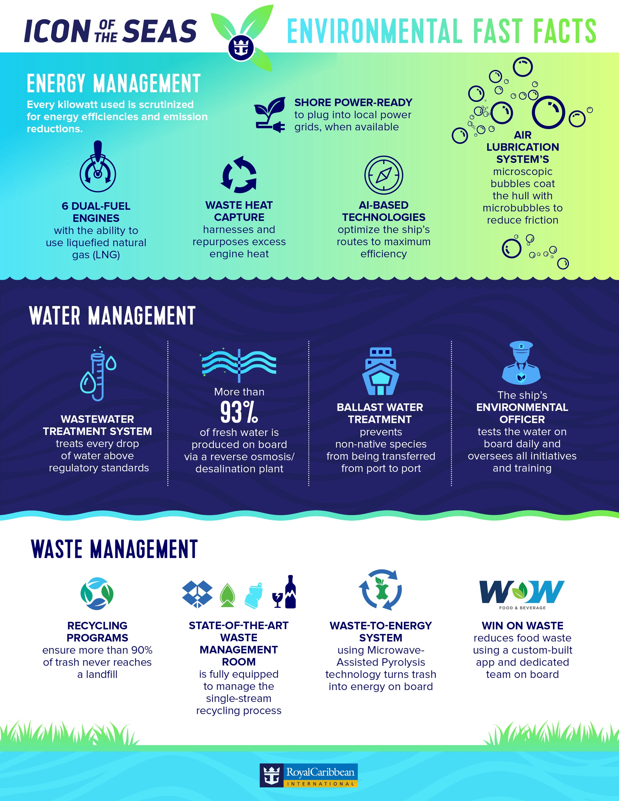
Icon of the Seas environmental initiatives

Slide 14
Sustainability in the hospitality sector: Events and festivals
Organizers of events and festivals are beginning to take a proactive approach to sustainability. Many are recognizing that large events do not have to have a huge climate impact and, in fact, can play a positive role by becoming low-carbon or even carbon neutral.
For events, one method of promoting sustainability initiatives is through certification. AGF (A Greener Festival) is a leader in helping events, festivals and venues globally to become greener.
One successfully certified event is the We Love Green Festival in France.
“Sustainability has been at the heart of We Love Green’s production and contents since the beginning. We are pleased that our innovations and advances are followed and recognized by international institutions. They require moving the lines, rules, standards, habits, and all the festival teams are involved in this daily work”.

Slide 15
Sustainability and customer service
1. Customer expectations: Good customer service now often includes transparent communication about sustainability efforts, such as how products are sourced or how a company manages waste.
2. Brand loyalty and trust: Companies that demonstrate a commitment to sustainability can build stronger relationships with their customers and build loyalty and trust.
3. Enhanced customer experience: Research has found that sustainable practices can improve the overall customer experience
4. Employee engagement: Employees who are engaged in sustainability efforts often provide better customer service.

Slide 16
Sustainability and customer service
5. Product innovation: Customer feedback can drive companies to innovate in more sustainable ways.
6. Education and advocacy: Customer service teams can play a role in educating customers about sustainability practices and the benefits of eco-friendly choices.
7. Service quality perceptions: The customer service provided by an organization can also influence how sustainability efforts are perceived by customers.
8. The service profit chain: Finally, as demonstrated by the service profit chain (see Chapter 2), the customer loyalty engendered by sustainability initiatives will ultimately lead to profitability for an organization.

Slide 17
Case study: Taj Hotels
The Taj Group is the largest hotel, leisure and hospitality company in Southeast Asia, and for many years has been a leader in sustainability in the hospitality sector.
Today, about a third of Taj hotels are EarthCheck certified which has triggered competition among all Taj hotels across the world to outperform each other in their environmental performance.
Taj’s sustainability efforts are guided by Paathya, a comprehensive Environmental Social Governance (ESG) framework launched in 2022
‘Paathya,’ derived from the Sanskrit word ‘path,’ means both ‘way’ and ‘solution’, and is based on six pillars: environmental stewardship, social responsibility, excellence in governance, value chain transformation, sustainable growth and preserving heritage

